Slide 1


Smart City and IOT (Internet of Things)
in China
— The convergence and inevitable trend of industrialization, urbanization and informatization

Slide 2



Outline
Problems and challenges from urbanization
Relationship between Smart City and IOT (Internet of Things)
Smart City in China
Future and Challenges

Slide 3
Cities in the new Millennium
Today, more than half of world population live in cities. Urbanization has become the most significant economic feature.
Today in China, 500 million people live in cities. This number will be doubled by 2030.
However, rapidly expanding cities also bring pains and challenges to human lives.
Our earth has become a huge network and alliance of cities.

Slide 4








Cities are facing great challenges
Sustainable development of cities is facing grand challenges.
Globally, cities
Consume 75% of energy
Consume 60% of water resource
Emit 80% of greenhous
Rapidly expanding cities also bring pains and challenges
to human lives.
Traffic congestion
Energy shortage
Environmental pollution
Frequent natural disasters and emergencies
Not only the life quality of city residents, but also the safety of
our earth is challenged.

Slide 5


How to solve these urgent challenges?
The problems faced by urbanization require us to have systems and methods for planning, precise management and predictive alert, to use informative and intelligent infrastructure as the supports for solving city problems.
In the future, collaborative management and services should be highlighted. Policies and mindsets of city management have to be changed.
It means that we need establish the smart city.

Slide 6


Information technology as support
Continuously evolving Information Technology provides means for solving these problems (such as sustainability, energy saving and fine dynamic management). Specially, through IT system construction based on cutting-edge science and technology, the urbanization can be solved.

Slide 7
The concept of smart city
Smart City is the product of accelerated development of the new generation information technology and knowledge-based economy;
Based on the network combination of the Internet, telecommunications network, broadcast network, wireless broadband network and other networks,IoT technology as the core.
Main features including a high degree of information technology integration, comprehensive application of information resources.

Slide 8





















The new model or essential components of urban development should including:
Smart technology
Smart management
Smart industry
Smart City
Smart services
Smart life

Slide 9










Build unified management and collaboration intelligent city
Establish intelligent city Framework
IT
ability
CT
ability
Data center
Communication
network
Internet
IOT
Cell phone
Vedio phone
Call center
WIFI
internet
Camera
RFID
wireless sensor network
Unified platform, set up a city, the construction of the data center three zhang basic network, through the layered construction, to achieve the ability and the application of the platform can grow, expanded, create the future city system, intelligent framework.
9

Slide 10




A future green intelligent city with IOT technology
Green and
harmonious Industry
Safe and orderly city
Efficient and transparent government
Happy and healthy life
To build future-oriented intelligent city
Clear perception and
measurement
Safe access and
interconnection
Smart City
Unified platform and
collaboration
smart analysis and interaction

Slide 11


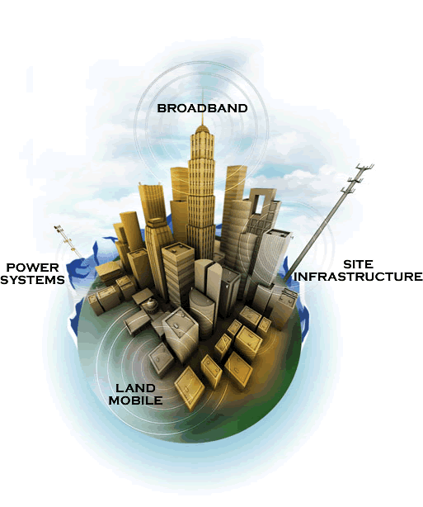




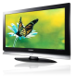


Building an appreciable city
Perception
Access
Smart
Integration

Slide 12
Intelligent cities will be the communication between people of P2P expanded into the machine and machine of the communication between M2M;
Communications network + Internet + content networking constitute the basis of network information intelligent city;
In "3 web" on superposition city informatization and make cities more intelligent;
Based on the unified frame integration platform, and give full play to the coordination effect;

Slide 13
The Green intelligent city Solution
Establish a clear development planning
Build a appreciable city
Build unified management and intelligent city
Build a complete and scientific standard
Looking for a suitable building model

Slide 14



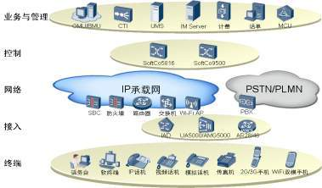
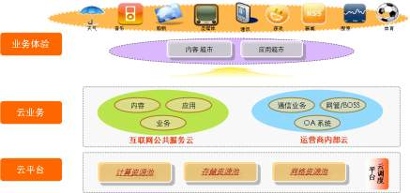
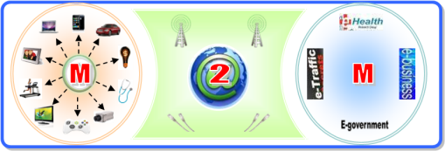



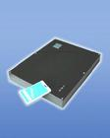


Smart city solution
Application Layer
Efficient Government
Safe city
Green Industry
Happy Life
Platform Layer
VAE
App Integration
IDC
IT Engine
CT Engine
M2M Engine
Network Layer
Communication Network
Internet
M2M network
Sensor Layer
PC
Mobile
RFID Reader
Camera
Information collect terminal
Sensor network terminal

Slide 15
IOT will be the foundation of smart city construction
In 2010, IoT hot spots, highlights and view points were emerging frequently and constantly. IoT, as a strategic emerging industry, advanced rapidly under the government’s great attention. For the first time, IoT got into the government work report, and was listed as a major program in the national 12th 5-Year planning. Each province and city actively launched the IoT industry development plan. The IoT industry has demonstrated a strong potential for development.

Slide 16
Seven strategic emerging industries
Now China has further proposed seven strategic emerging industries:
Energy-saving environmental protection
High-end equipment manufacturing
Bio-industry
New materials industry
New generation IT industry (including IOT industry),
New energy industry
New energy vehicles

Slide 17
China government policy regarding Smart city
Strengthening planning guidance and policy guidance
1
2
Vigorously promote technology innovation
Policy
To speed up the construction of the standard system
3
4
Actively promote application demonstration
5
Explore innovative business model

Slide 18
Smart Beijing
Smart Beijing will boost ten things networking application fields
  The city emergency management field
  Social security area, including the entire traffic flow, people and large activities and social security
  Communications, increase the application of information to improve efficiency
  Municipal city management application fields
  Environmental monitoring supervision areas
  Water management field
  Production safety supervision areas
  Energy conservation and emission reduction detection supervision areas
  Medical health field
  Agricultural and other regulatory field

Slide 19
Shanghai announced the "smart city" construction plan
According to this plan, by 2013, 100Mbps fiber will stretch to the doors of the city's 6.5 million families, and achieve full coverage of urban areas. By then, the city's average home internet access bandwidth will reach 20Mbps, which is five times of the number earlier this year.
Under the plan, Shanghai will establish electronic health records for all citizens. Information sharing among connected medical institutions can improve the quality of care, reduce errors, and reduce pain and extra burden of patients.
According to this plan, our food safety problems, road congestion issues, community service issues, quality education resource sharing problems can all be solved

Slide 20
Hangzhou recently released "Hangzhou IoT industry development plan (2010-2015)
According to the plan, Hangzhou will focus on promoting the four pilot demonstration projects including
Smart City, Smart Life, Smart “industrialization and informatization“, and smart environmental monitoring.
The industry will focus on the development of four key areas including advanced sensors and wireless sensor networks, network transmission, data storage and analysis of decision-making, IoT systems integration and standardization

Slide 21
China Smart City Sustainability Index Launched in Beijing
On August 28, 2011, the press conference for the release of China Smart City (Town) Sustainability Index was held in Beijing. The index uses the Happiness Index, Management Index and Social Responsibility Index to assess a city’s development level. The experts believe that, developing Smart City is a critical measure to improve the quality of urbanization and facilitate the innovation of city’s economy, living and management during 12th Five Year Plan period. Developing Smart City is to integrate information technology with advanced idea of urban management & service, through the digital management of urban geography, resources, environment and economy, to provide a more efficient, convenient and flexible public management model. The indexes System include 3 one class indexes, 23 secondary level indexes, 86 third level indexes and 362 specific fourth level indexes. This is also the first indexes system related to Smart City in China.

Slide 22


END

